Slide 1
Machine Learning In PHYsics FoundationS 1
Harrison B. Prosper
PHY6937 / PHY4936 Fall 2025

Slide 2
Goals of this Course
Gain a good understanding of the mathematical basis of machine learning (ML).
Gain experience building ML models using PyTorch to solve data science problems in physics.
Gain experience with different ML models.
Gain an appreciation of the power of ML models as well as their (current) limitations.

Slide 3
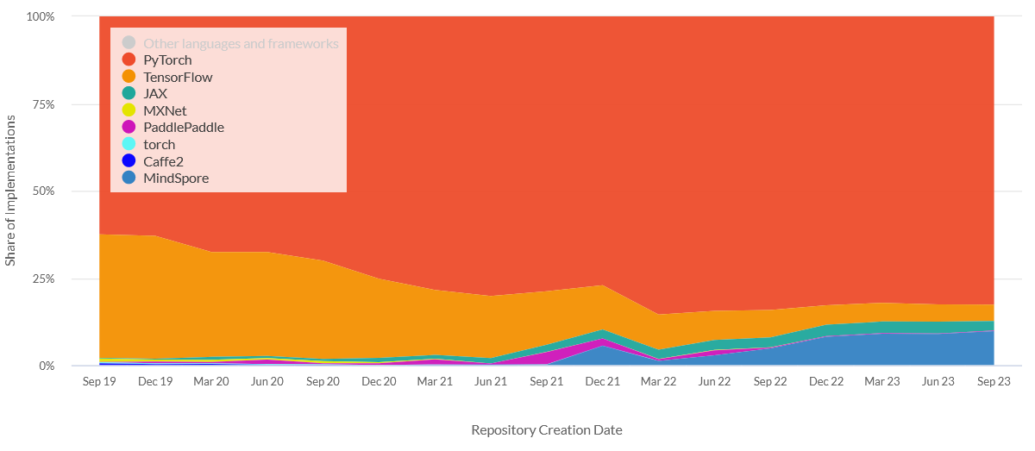
Why PyTorch?
https://viso.ai/deep-learning/pytorch-vs-tensorflow/

Slide 4
What is Artificial Intelligence?
Artificial Intelligence
Algorithms that cause machines to exhibit human- or superhuman-level intelligence.

Slide 5
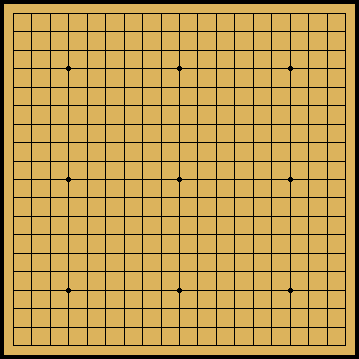
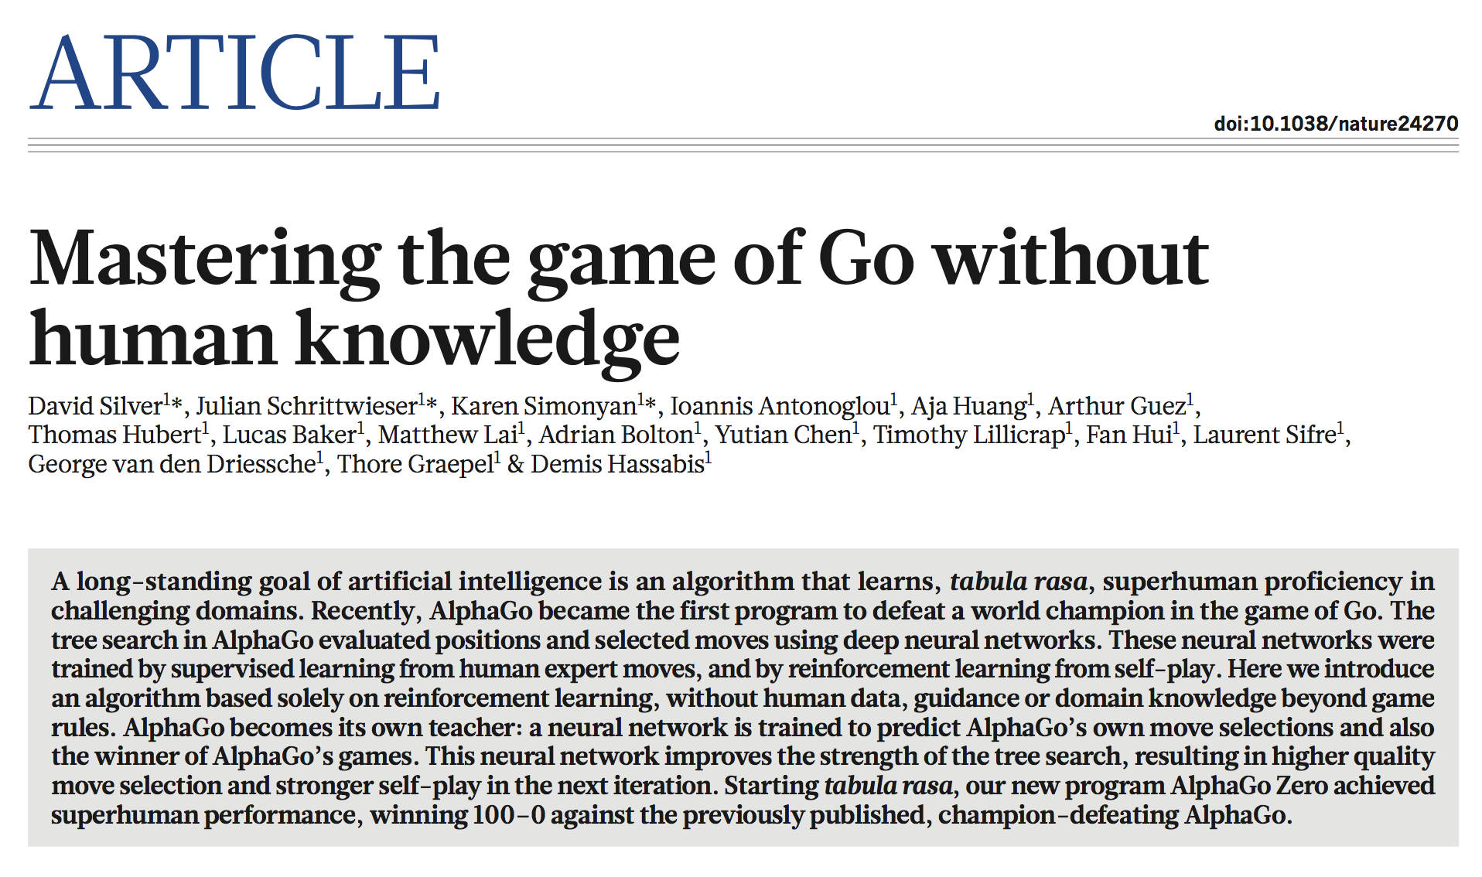
356 | NATURE | VOL 550 | 19 OCTOBER 2017

Slide 6
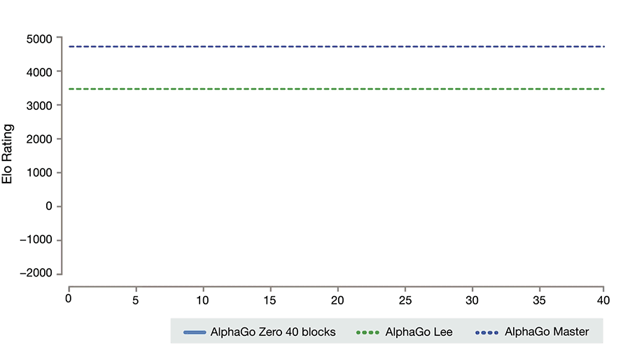
https://deepmind.com/blog/alphago-zero-learning-scratch/

Slide 7


Symbolic Mathematics
In December 2019, Guillaume Lample and François Charton* (Meta fka Facebook AI Research, Paris) claimed: “We achieve results that outperform commercial Computer Algebra Systems such as Matlab or Mathematica.”
* G. Lample and F. Charton, Deep Learning for Symbolic Mathematics, arXiv: 1912.01412v1
Lample
Charton

Slide 8
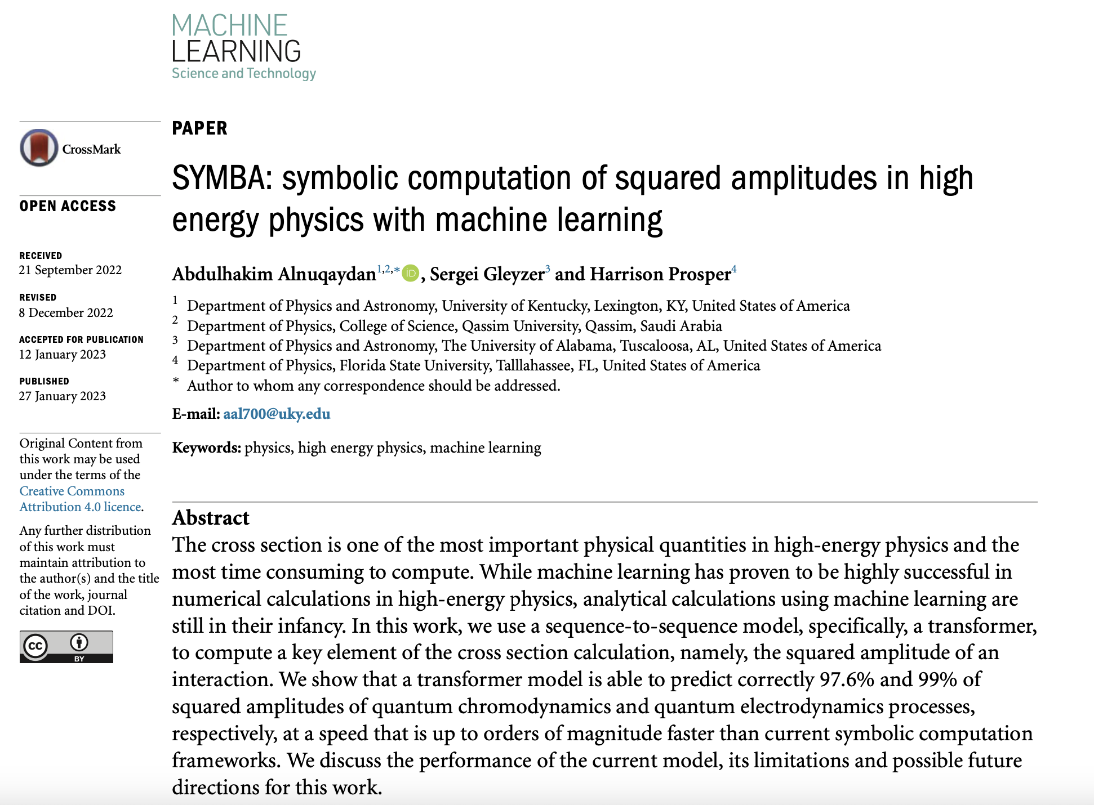

Slide 9
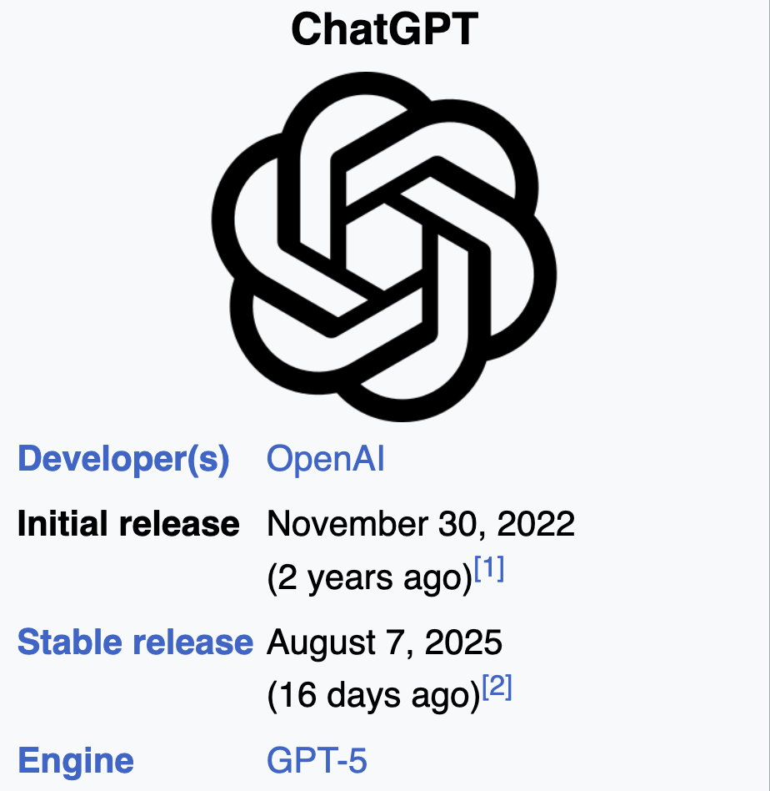

Slide 10
What is Machine Learning?
Artificial Intelligence
Algorithms that cause machines to exhibit human- or super-human level intelligence.
Machine Learning
Algorithms for modeling data.

Slide 11
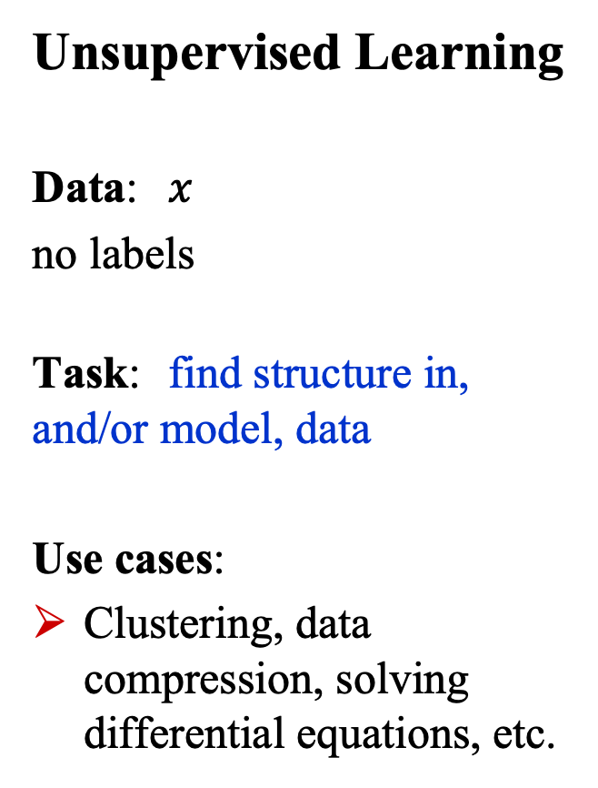
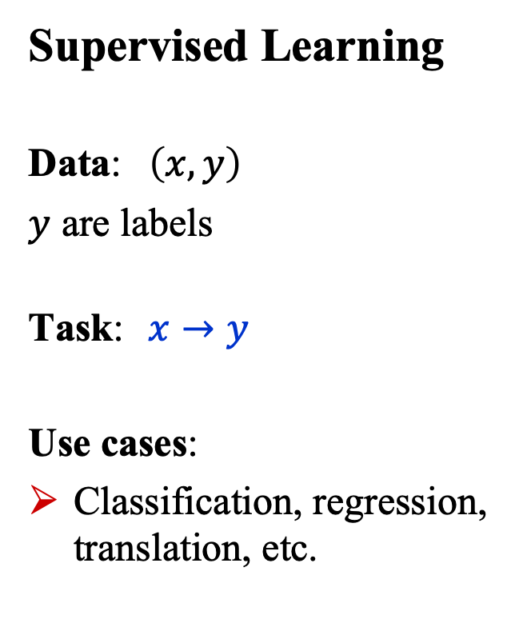
What is Machine Learning?
Supervised Learning
Data: $\left(x, y\right)$
$y$ are labels
Task: $x→y$
Use cases:
Classification, regression, translation, etc.
Unsupervised Learning
Data: $x$
no labels
Task: find structure in, and/or model, data
Use cases:
Clustering, data compression, solving differential equations, etc.

Slide 12
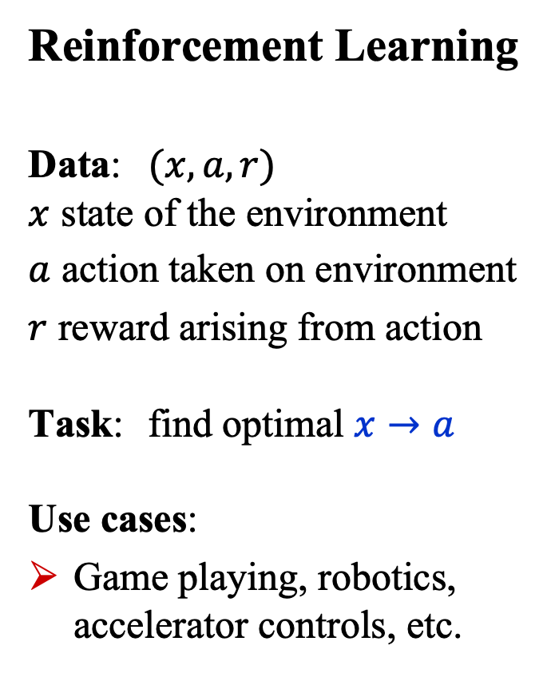
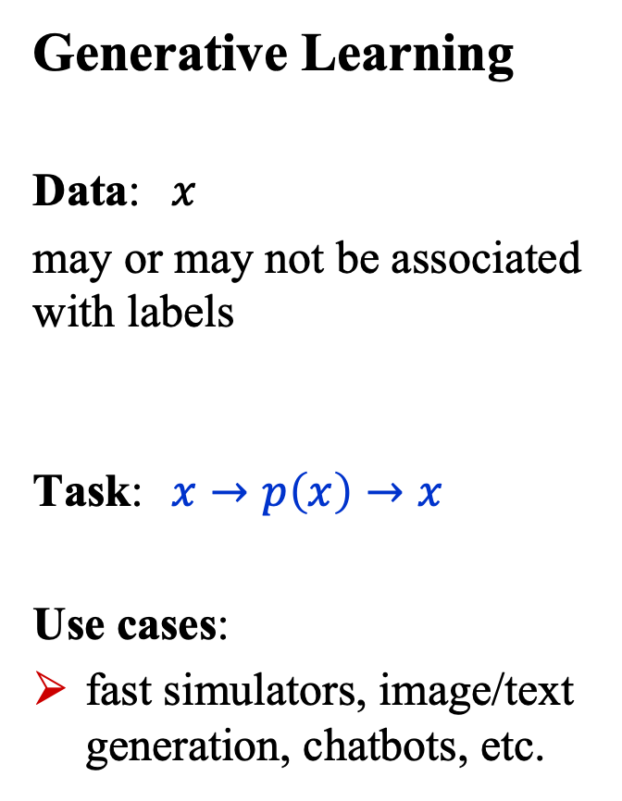
What is Machine Learning?
Generative Learning
Data: $x$
may or may not be associated with labels
Task: $x→p\left(x\right)→x$
Use cases:
fast simulators, image/text generation, chatbots, etc.
Reinforcement Learning
Data: $(x,a,r)$ $x$ state of the environment
$a$ action taken on environment
$r$ reward arising from action Task: find optimal $x→a$ Use cases:
Game playing, robotics, accelerator controls, etc.

Slide 13
What is Deep Learning?
Artificial Intelligence
Algorithms that cause machines to exhibit human- or super-human-level intelligence.
Machine Learning
Algorithms for modeling data
Deep Learning
ML using (large) neural networks

Slide 14
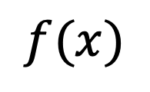
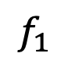
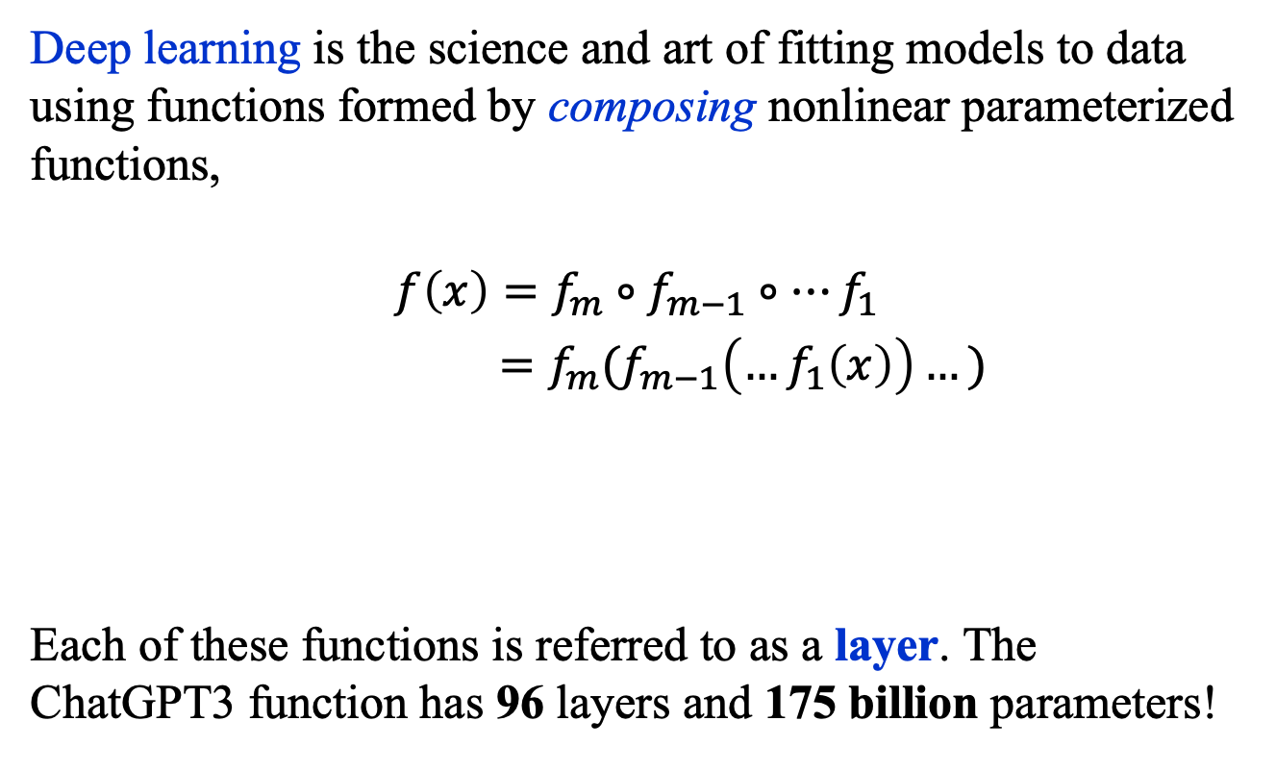
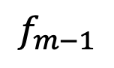
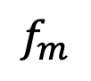
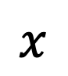
What is Deep Learning?
Deep learning is the science and art of fitting models to data using functions formed by composing nonlinear parameterized functions,
$$f\left(x\right)=f_{m}∘f_{m−1}∘…f_{1}$$
$=f_{m}(f_{m−1}\left(…f_{1}\left(x\right)\right)…)$
Each of these functions is referred to as a layer. The ChatGPT3 function has 96 layers and 175 billion parameters!
$$f(x)$$
…
$$x$$
$$f_{m}$$
$$f_{m−1}$$
$$f_{1}$$

Slide 15
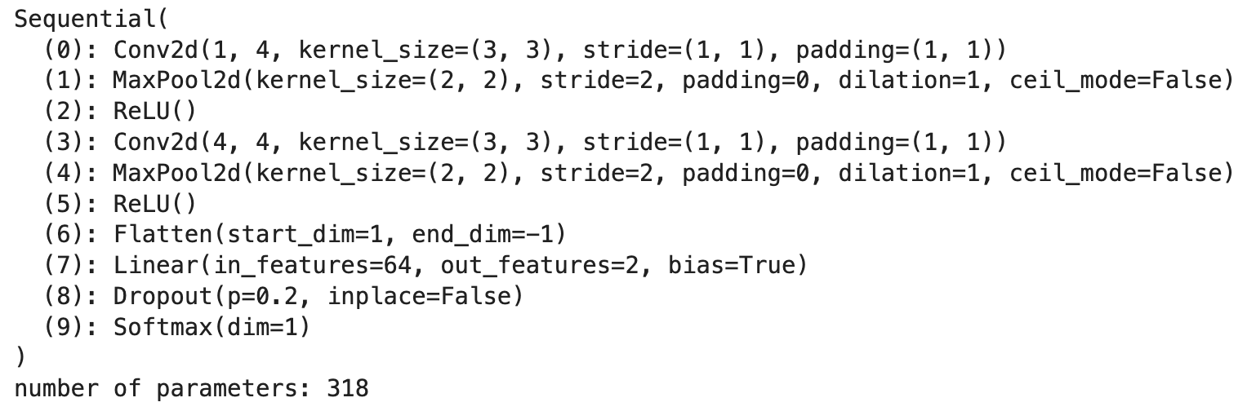
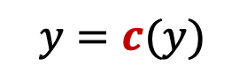
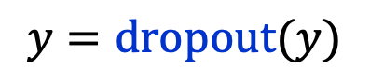
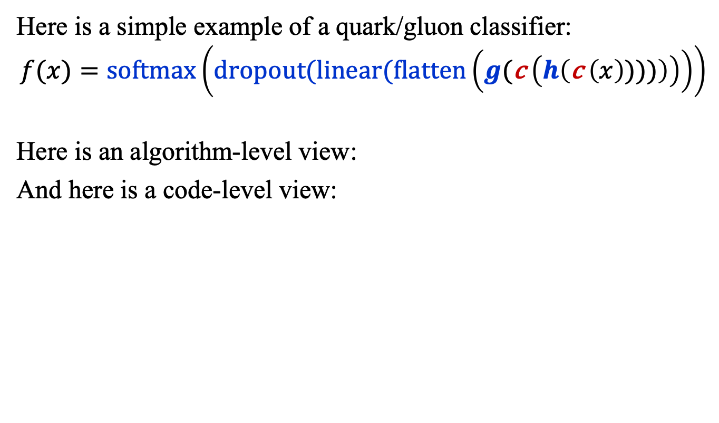
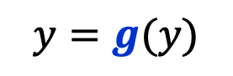
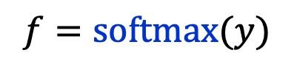
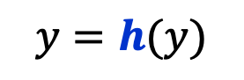
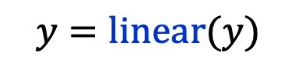
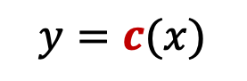
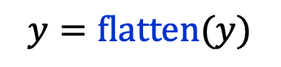
What is Deep Learning? Example
Here is a simple example of a quark/gluon classifier:
$$f(x)=\text{softmax}\left(dropout(linear(flatten\left(g(\text{c} \left(h\left(\text{c} \left(x\right))))\right)\right)\right)\right)$$
Here is an algorithm-level view:
And here is a code-level view:
$$y=c(x)$$
$$y=\text{flatten}(y)$$
$$y=h(y)$$
$$y=\text{linear}(y)$$
$$y=c(y)$$
$$y=\text{dropout}(y)$$
$$y=g(y)$$
$$f=\text{softmax}(y)$$

Slide 16
Basic building block: The perceptron

Slide 17
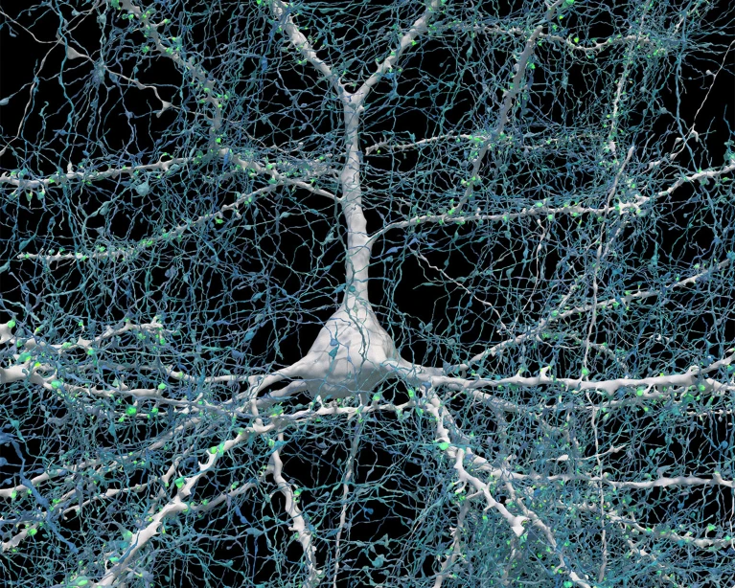
The Brain’s Computational Unit
https://www.nature.com/articles/d41586-024-01387-9

Slide 18
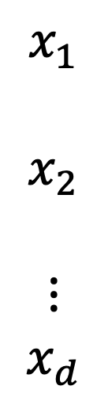
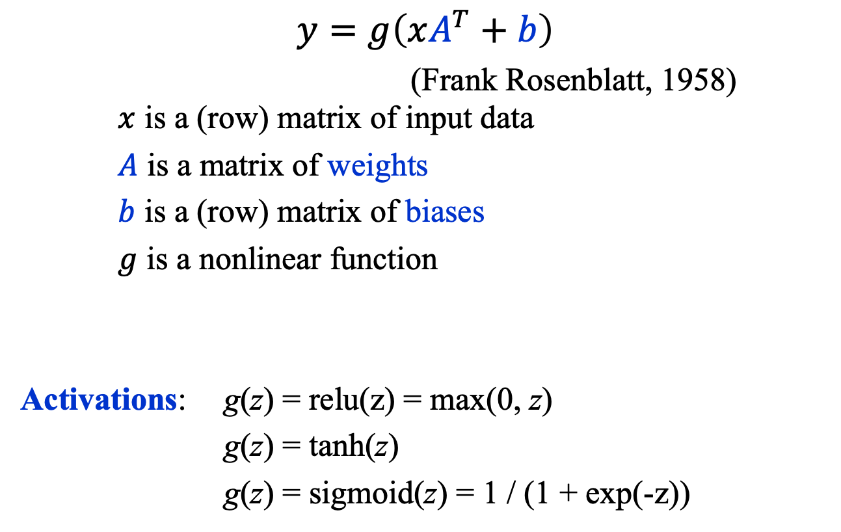

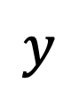
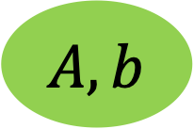
Artificial Comp. Unit: The Perceptron
$$y=g\left(xA^{T}+b\right)$$
(Frank Rosenblatt, 1958) $x$ is a (row) matrix of input data
$A$ is a matrix of weights
$b$ is a (row) matrix of biases
$g$ is a nonlinear function
Activations: g(z) = relu(z) = max(0, z)
g(z) = tanh(z)
g(z) = sigmoid(z) = 1 / (1 + exp(-z))
$$x_{1}$$
$$x_{2}$$
$$⋮$$
$$x_{d}$$
$$y$$
$$g$$
$$A, b$$
https://news.cornell.edu/stories/2019/09/professors-perceptron-paved-way-ai-60-years-too-soon

Slide 19
Multi-Node perceptron

Slide 20
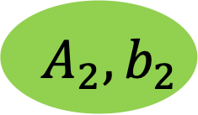
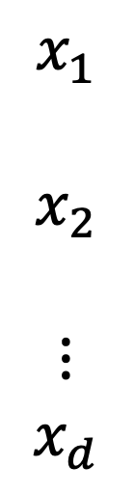
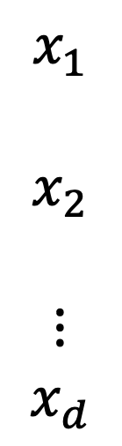
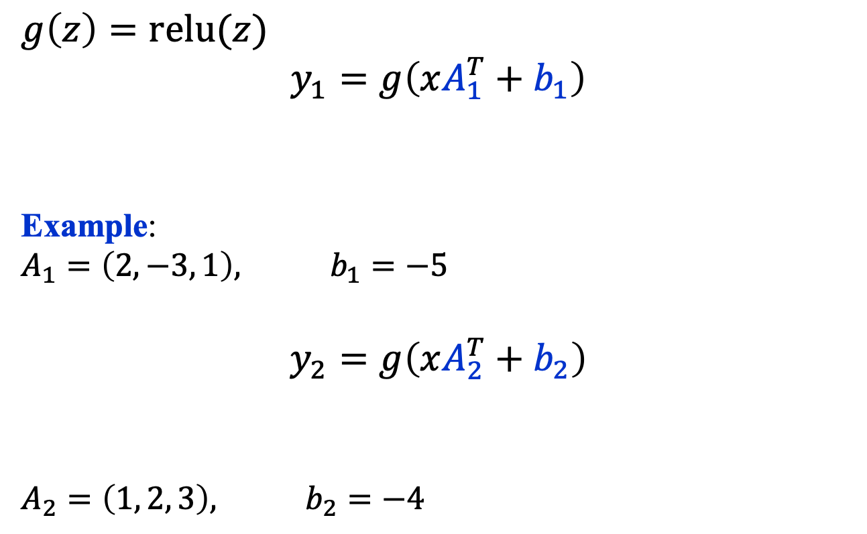

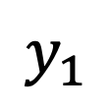

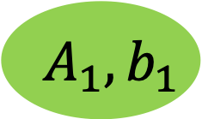
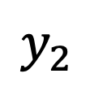
Multi-Node Perceptron
$$x_{1}$$
$$x_{2}$$
$$⋮$$
$$x_{d}$$
$$g\left(z\right)=\text{relu}(z)$$
$$y_{1}=g\left(xA_{1}^{T}+b_{1}\right)$$
Example:
$$A_{1}=\left(2,−3, 1\right), b_{1}=−5$$
$$y_{2}=g\left(xA_{2}^{T}+b_{2}\right)$$
$$A_{2}=\left(1, 2, 3\right), b_{2}=−4$$
$$y_{1}$$
$$g$$
$$A_{1}, b_{1}$$
$$x_{1}$$
$$x_{2}$$
$$⋮$$
$$x_{d}$$
$$y_{2}$$
$$g$$
$$A_{2}, b_{2}$$

Slide 21
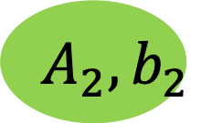
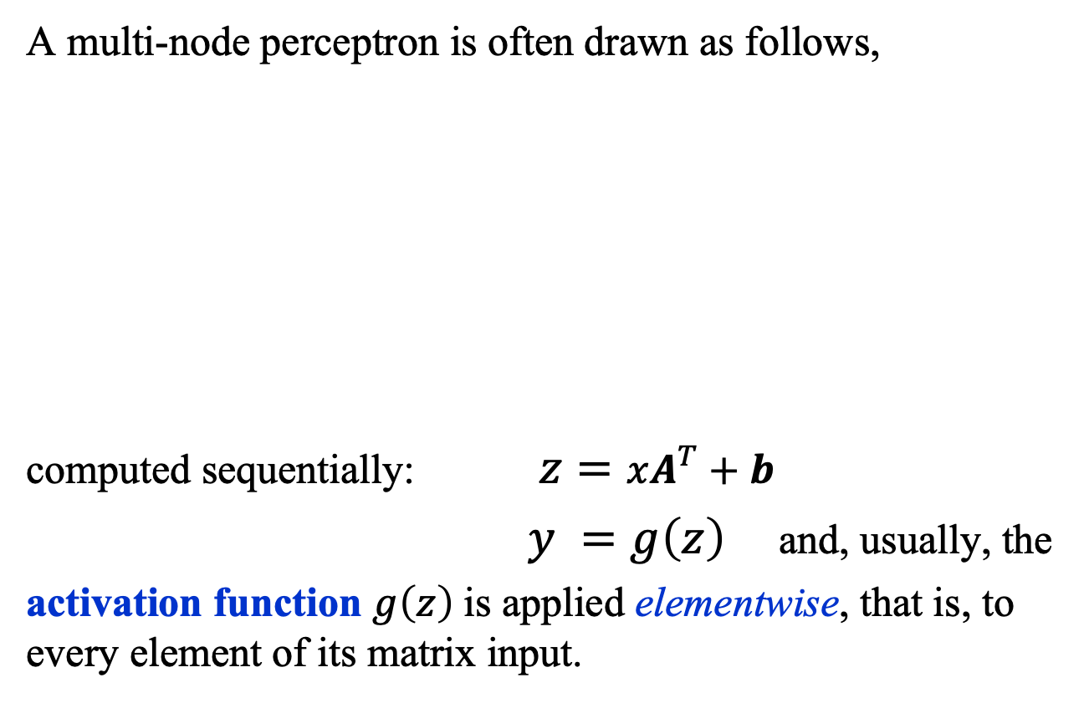

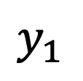
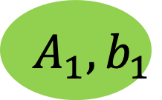

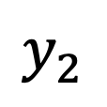
Multi-Node Perceptron
A multi-node perceptron is often drawn as follows,
computed sequentially: $z=xA^{T}+b$
$y =g\left(z\right)$ and, usually, the
activation function $g\left(z\right)$is applied elementwise, that is, to every element of its matrix input.
$$x_{1}$$
$$x_{2}$$
$$⋮$$
$$x_{d}$$
$$y_{1}$$
$$g$$
$$A_{1}, b_{1}$$
$$y_{2}$$
$$g$$
$$A_{2}, b_{2}$$

Slide 22
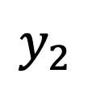
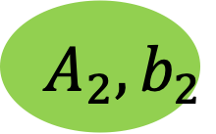
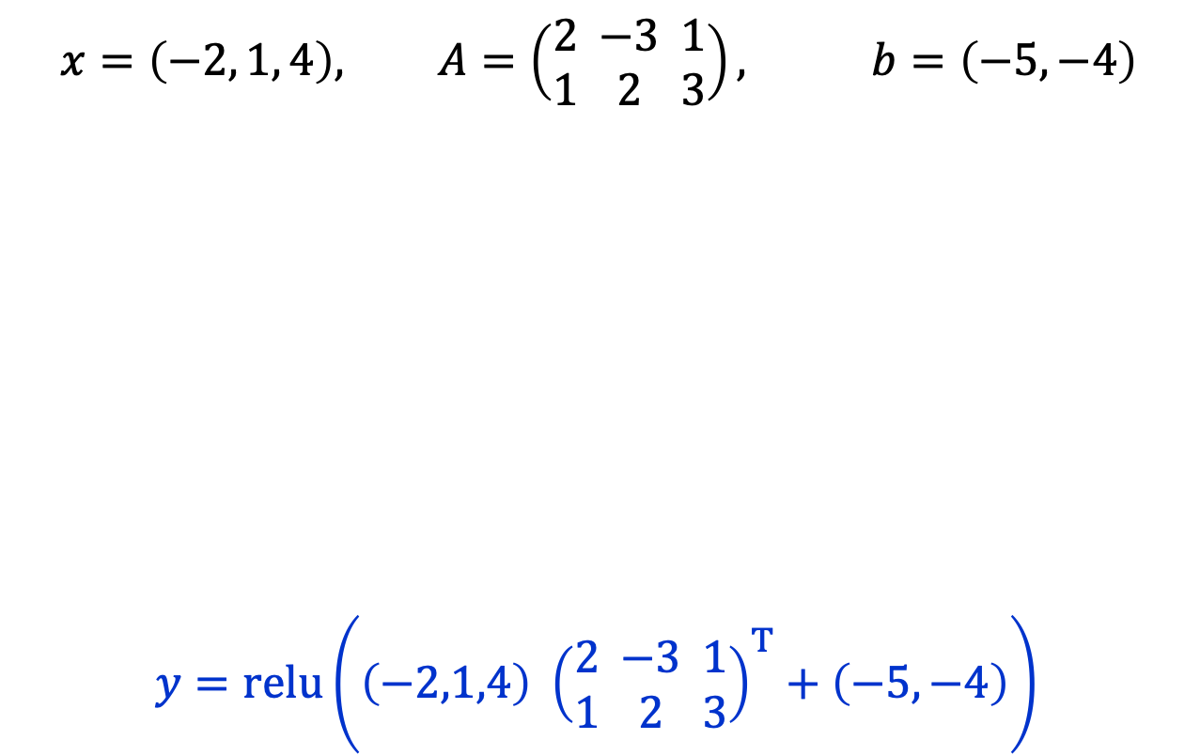

Multi-Node Perceptron: Example
$$x=\left(−2, 1, 4\right), A=\left(\begin{matrix}2 \\ 1\end{matrix}\begin{matrix} −3 \\ 2\end{matrix}\begin{matrix}1 \\ 3\end{matrix}\right), b=\left(−5,−4\right)$$
$y=\text{relu}\left(\left(−2,1,4\right) {\left(\begin{matrix}2 \\ 1\end{matrix}\begin{matrix} −3 \\ 2\end{matrix}\begin{matrix}1 \\ 3\end{matrix}\right)}^{T}+\left(−5,−4\right)\right)$
$$x_{1}$$
$$x_{2}$$
$$⋮$$
$$x_{d}$$
$$y_{1}$$
$$g$$
$$A_{1}, b_{1}$$
$$y_{2}$$
$$g$$
$$A_{2}, b_{2}$$

Slide 23
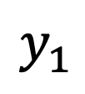
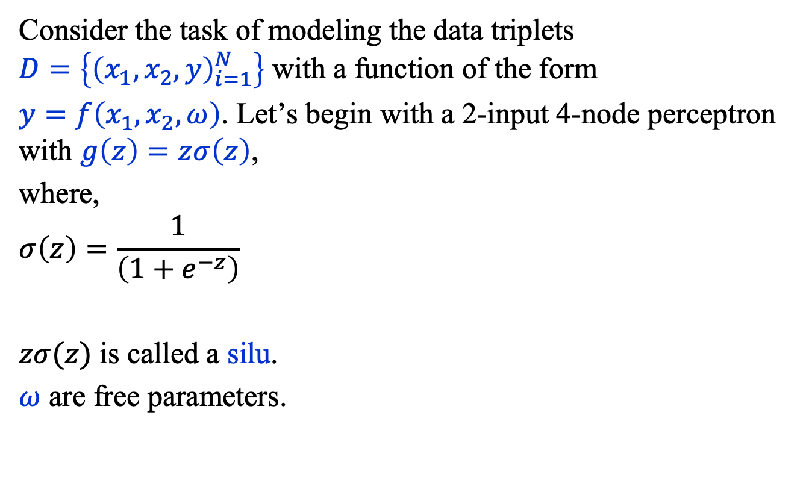
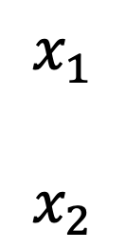

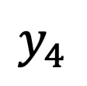




Multi-Node Perceptron
Consider the task of modeling the data triplets $D=\left\{{\left(x_{1},x_{2},y\right)}_{i=1}^{N}\right\}$ with a function of the form
$y=f\left(x_{1},x_{2},ω\right)$. Let’s begin with a 2-input 4-node perceptron with $g\left(z\right)=zσ\left(z\right)$,
where,
$$σ\left(z\right)=\frac{1}{\left(1+e^{−z}\right)}$$
$zσ(z)$ is called a silu.
$ω$ are free parameters.
$$y_{1}$$
$$y_{2}$$
$$x_{1}$$
$$x_{2}$$
$$y_{3}$$
$$y_{4}$$
$$g$$
$$A, b$$
$$≡$$

Slide 24




Multi-Node Perceptron
Then, let’s feed the output of the multi-node perceptron into a 4-input 1-node perceptron:
$$y_{1}$$
$$y=f\left(x_{1}, x_{2}, ω\right)$$
$$y_{2}$$
$$x_{1}$$
$$x_{2}$$
$$y_{3}$$
$$y_{4}$$
$$g$$
$$A, b$$
$$≡$$

Slide 25




Multi-Node Perceptron
Given the complexity of ML models (i.e., ML functions), it is now common to use a graphical representation of ML models that uses higher-level components.
$f\left(z\right)=zA^{T}+b$
$\text{relu}\left(z\right)=\text{max}\left(0, z\right)$
$σ(z)={\left(1+e^{−z}\right)}^{−1}$
output
$$σ(z)$$
Layer 2
Linear(4, 1)
$$\text{relu}(z)$$
Layer 1
Linear(2, 4)
$$x$$

Slide 26

Multi-Node Perceptron
Here, for example, is a graphical representation of a transformer, the model that powers ChatGPT.
In ChatGPT 3, there are 2 x 96 of these “layers”!

Slide 27
Loss function and Empirical risk

Slide 28


2D Dataset
In this part of the course, we’ll use a simple synthetic dataset comprising two classes of objects characterized by real numbers $(x_{1},x_{2})$.
The data are generated from two bivariate normal distributions.

Slide 29





Loss Functions
Suppose our goal is to approximate an unknown function
$y=f\left(x_{1},x_{2}\right)$
given a dataset $D=\left\{{\left(x_{1},x_{2},y\right)}_{i=1}^{N}\right\}$,
using the model on the right.
$$y(x)$$
$$σ(z)$$
Linear(4, 1)
$$\text{relu}(z)$$
Linear(2, 4)
$$x$$

Slide 30

Loss Functions
A well-known approach is to approximate $f\left(x_{1},x_{2}\right)$ with a parameterized function $f\left(x_{1},x_{2},ω\right)$ and find the best-fit values $ω^{∗}$ by minimizing
$$R\left(ω\right)=\frac{1}{N}\sum_{i=1 }^{N}{{\left(y_{i}−f_{i}\right)}^{2}}$$
with respect to the parameters $ω$, where $f_{i}=f\left(x_{1i}, x_{2i},ω\right)$.
This is referred to as a least-squared fit.

Slide 31

Loss Functions
In machine learning, the least-squares fit is generalized to
$$R\left(ω\right)=\frac{1}{N}\sum_{i=1 }^{N}{L\left(y_{i}, f_{i}\right)}$$
where the function, $L\left(y_{i}, f_{i}\right)$, called the loss function, measures the discrepancy between the desired target $y$ and the model $f$.
The quantity $R\left(ω\right)$ is called the empirical risk and the task of minimizing it is called empirical risk minimization.
Warning: In ML, $R\left(ω\right)$ is often referred to as the “loss”.

Slide 32


Empirical Risk: Landscape
The empirical risk defines a highly corrugated very high-dimensional “landscape” in the space of parameters.
The goal of an optimizer is to navigate
the landscape ($R\left(ω\right)$) associated with
a finite amount of data to find a good
approximation of the lowest point of
the landscape associated with an
infinite amount of data.
When ML researchers say that a
model generalizes this is what they mean.

Slide 33

Risk Functional
In mathematics, one can often gain insight by taking some limit of an expression. Let’s take the limit of
$$R\left(ω\right)=\frac{1}{N}\sum_{i=1 }^{N}{L\left(y_{i}, f_{i}\right)}$$
as $N→∞$, that is, as the amount of data grows without limit.
In that limit, the empirical risk becomes the risk functional,
$$R\left[f\right]=\int{dx}\int{dy L\left(y, f\right) p\left(x, y\right)}$$
where $p\left(x, y\right)dxdy$ is the probability distribution of the data.

Slide 34
Summary (1)
General Approaches
Supervised, unsupervised, generative, and reinforcement learning.
Deep Learning
Uses functions constructed through deep composition.
The Perceptron
Basic computational unit: matrix multiplication and addition and (typically) an element-wise nonlinear map.

Slide 35
Summary (2)
We described the multi-node perceptron and how machine learning models are represented graphically.
We illustrated the calculation of the output of a perceptron.
We discussed the generalization of least-squared fitting to empirical risk minimization.

